Slide 1
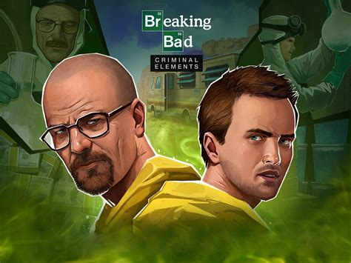

Slide 2
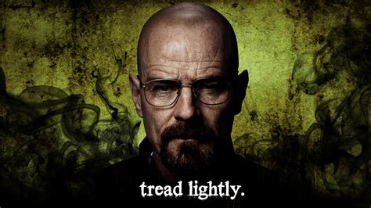
WHY IS THIS MY FAVORITE SERIES

Slide 3
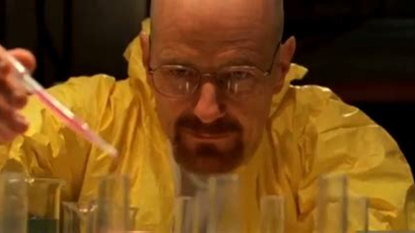

Slide 4
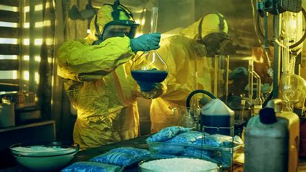

Slide 5
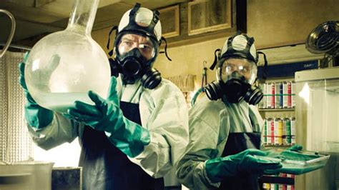

Slide 6
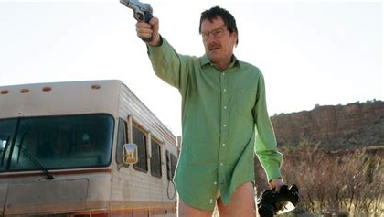

Slide 7
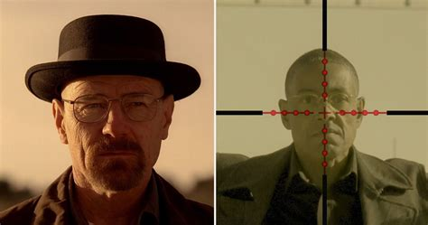

Slide 8
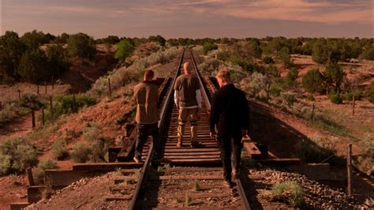

Slide 9
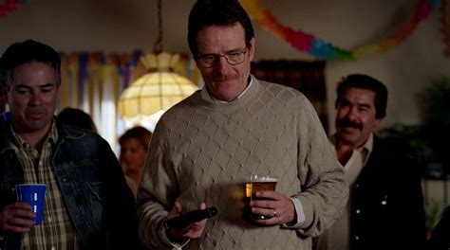

Slide 10
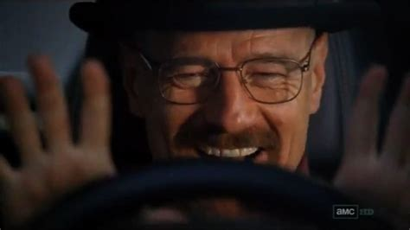

Slide 11
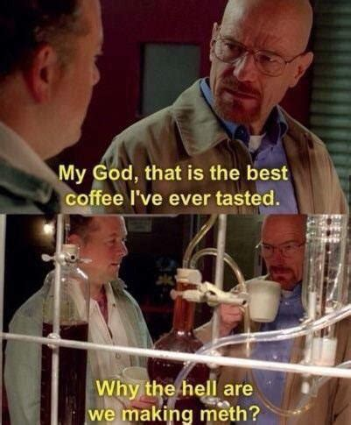

Slide 12
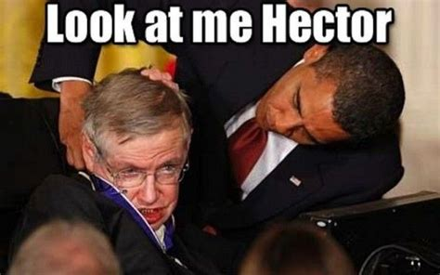

Slide 13
OPSS

Slide 14
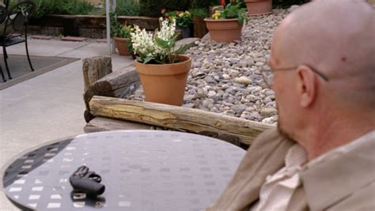

Slide 15
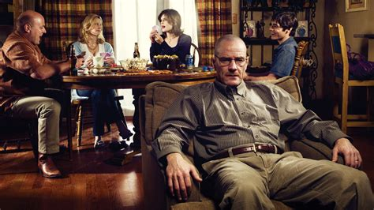

Slide 16
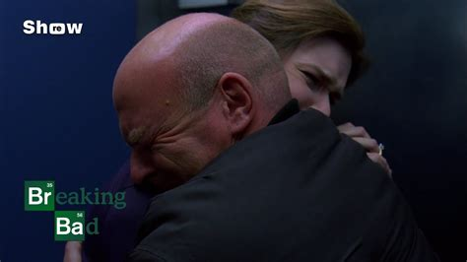

Slide 17
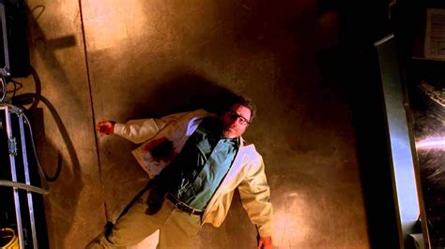

Slide 18
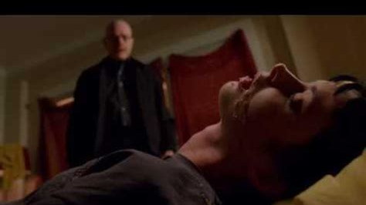

Slide 19
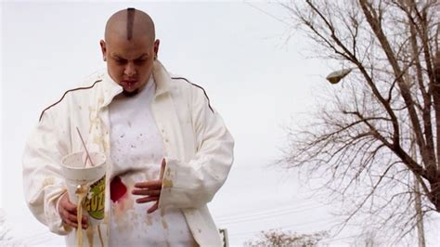

Slide 20
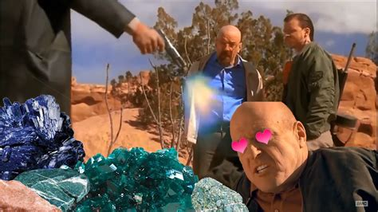

Slide 21
OPSSS

Slide 22
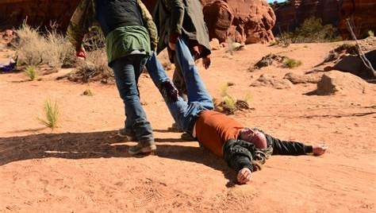

Slide 23
AND

Slide 24
THIS MAN

Slide 25
IS

Slide 26


Slide 27
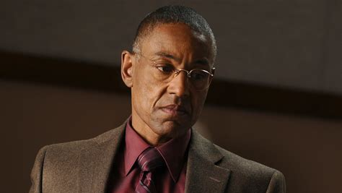

Slide 28
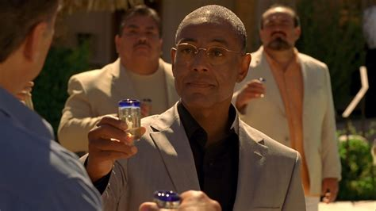

Slide 29
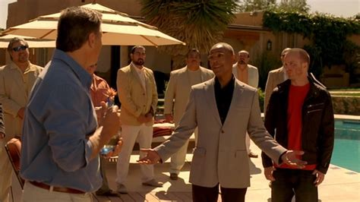

Slide 30
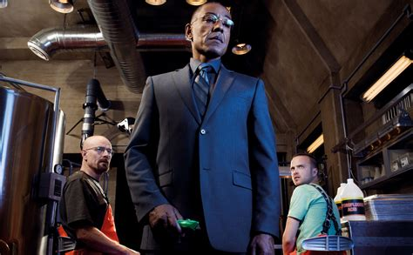

Slide 31
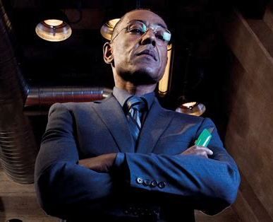
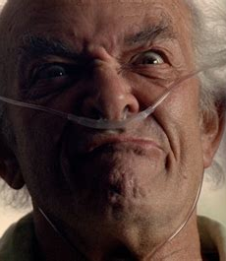

Slide 32
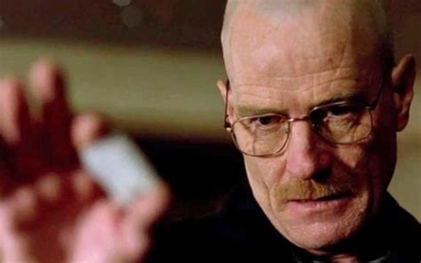
Am I the ony one who liked it?

Slide 33
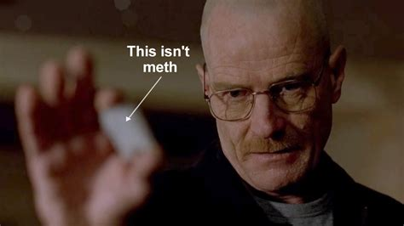

Slide 34
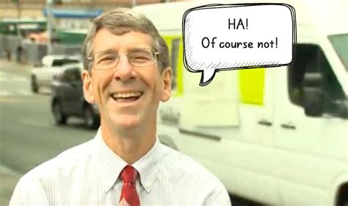

Slide 35
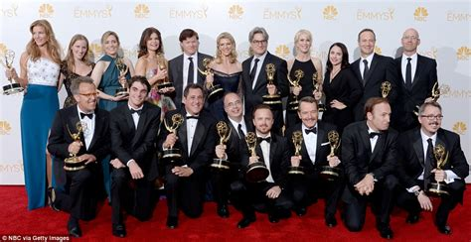

Slide 36
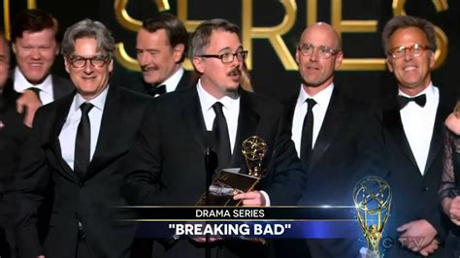

Slide 37
Ceremony
Category
Nominee(s)
Result
60th Primetime Emmy Awards
Outstanding Directing in a Drama Series
Vince Gilligan ("Pilot")
Nominated
Outstanding Lead Actor in a Drama Series
Bryan Cranston ("Pilot")
Won
Outstanding Cinematography for a One Hour Series
John Toll ("Pilot")
Nominated
Outstanding Single-Camera Picture Editing for a Drama Series
Lynne Willingham ("Pilot")
Won
13th Satellite Awards
Best Actor in a Television Series – Drama
Bryan Cranston
Won
35th Saturn Awards
Best Television Presentation
Breaking Bad
Nominated
Best Actor on Television
Bryan Cranston
Nominated
24th TCA Awards
Outstanding New Program
Breaking Bad
Nominated
61st Writers Guild of America Awards
Best New Series
Breaking Bad
Nominated
Best Episodic Drama
Vince Gilligan ("Pilot")
Won
Patty Lin ("Gray Matter")
Nominated
58th American Cinema Editors Eddie Awards
Best Edited One-Hour Series for Commercial Television
Lynne Willingham ("Pilot")
Won
PRISM Awards 2009
Best Drama Series Multi-Episode Storyline
Breaking Bad
Won
Best Performance in a Drama Multi-Episode Storyline
Bryan Cranston
Nominated
IGN Awards 2010
Best New Series
Breaking Bad
Nominated
Best Actor
Bryan Cranston
Won
American Film Institute Awards 2008
Best Television Program of the Year
Breaking Bad
Won
2010 Artios Awards
Outstanding Achievement in Casting: Television Series – Drama
Sharon Bialy and Sherry Thomas
Nominated
2008 Peabody Awards
Area of Excellence
Breaking Bad
Won
2009 PEN Center USA West Literary Awards
Best Teleplay
George Mastras ("Crazy Handful of Nothin'")
Won
Producers Guild of America Awards 2009
Television Producer of the Year Award in Episodic Drama
Breaking Bad
Nominated
Season 2
Ceremony
Category
Nominee(s)
Result
61st Primetime Emmy Awards
Outstanding Drama Series
Breaking Bad ("Grilled", "Peekaboo", "Better Call Saul", "4 Days Out", "Phoenix", "ABQ")
Nominated
Outstanding Lead Actor in a Drama Series
Bryan Cranston ("Phoenix")
Won
Outstanding Supporting Actor in a Drama Series
Aaron Paul ("Peekaboo")
Nominated
Outstanding Cinematography for a One Hour Series
Michael Slovis ("ABQ")
Nominated
Outstanding Single-Camera Picture Editing for a Drama Series
Lynne Willingham ("ABQ")
Won
16th Screen Actors Guild Awards
Outstanding Performance by a Male Actor in a Drama Series
Bryan Cranston
Nominated
14th Satellite Awards
Best Television Series – Drama
Breaking Bad
Won
Best Actor in a Television Series – Drama
Bryan Cranston
Won
36th Saturn Awards
Best Syndicated/Cable Television Series
Breaking Bad
Won
Best Actor on Television
Bryan Cranston
Nominated
Best Actress on Television
Breaking Bad
Nominated
Best Supporting Actor on Television
Aaron Paul
Won
Best Guest Starring Role on Television
Raymond Cruz
Nominated
25th TCA Awards
Outstanding Achievement in Drama
Breaking Bad
Nominated
Individual Achievement in Drama
Bryan Cranston
Won
62nd Writers Guild of America Awards
Best Dramatic Series
Breaking Bad
Nominated
Best Episodic Drama
John Shiban ("Phoenix")
Nominated
59th American Cinema Editors Eddie Awards
Best Edited One-Hour Series for Commercial Television
Lynne Willingham ("ABQ")
Won
PRISM Awards 2010
Best Drama Series Multi-Episode Storyline
Breaking Bad
Won
Best Performance in a Drama Series Multi-Episode Storyline
Bryan Cranston
Nominated
Aaron Paul
Nominated
IGN Awards 2010
Best Television Series
Breaking Bad
Won
Best Drama Series
Breaking Bad
Won
Best Performance
Bryan Cranston
Won
2010 Edgar Allan Poe Awards
Best Television Episode Teleplay
George Mastras ("Grilled")
Nominated
2010 Humanitas Prize
60 Minute Category
Breaking Bad ("Peekaboo")
Nominated
2010 PEN Center USA West Literary Awards
Best Teleplay
Moira Walley-Beckett ("Over")
Nominated
John Shiban ("Phoenix")
Nominated
Producers Guild of America Awards 2010
Television Producer of the Year Award in Episodic Drama
Breaking Bad
Nominated
2009 Gold Derby Awards
Best Drama Lead Actor
Bryan Cranston
Won
Best Drama Supporting Actor
Aaron Paul
Won
Season 3
Ceremony
Category
Nominee(s)
Result
62nd Primetime Emmy Awards
Outstanding Drama Series
Breaking Bad ("No Más", "Sunset", "One Minute", "Fly", "Half Measures", "Full Measure")
Nominated
Outstanding Directing in a Drama Series
Michelle MacLaren ("One Minute")
Nominated
Outstanding Lead Actor in a Drama Series
Bryan Cranston ("Full Measure")
Won
Outstanding Supporting Actor in a Drama Series
Aaron Paul ("Full Measure")
Won
Outstanding Cinematography for a One Hour Series
Michael Slovis ("No Más")
Nominated
Outstanding Single-Camera Picture Editing for a Drama Series
Skip Macdonald ("No Más")
Nominated
Outstanding Sound Editing for a Series
Nick Forshager, Kathryn Madsen, Mark Cookson, Cormac Funge, Jane Boegel, Jason Newman, Gregg Barbanell, and Dominique Decaudain-Tabach ("No Más")
Nominated
69th Golden Globe Awards
Best Actor in a Television Series – Drama
Bryan Cranston
Nominated
17th Screen Actors Guild Awards
Outstanding Performance by a Male Actor in a Drama Series
Bryan Cranston
Nominated
15th Satellite Awards
Best Television Series – Drama
Breaking Bad
Won
Best Actor in a Television Series – Drama
Bryan Cranston
Won
Best Supporting Actor in a Series, Miniseries, or Television Film
Aaron Paul
Nominated
37th Saturn Awards
Best Syndicated/Cable Television Series
Breaking Bad
Won
Best Actor on Television
Bryan Cranston
Nominated
Best Supporting Actor on Television
Dean Norris
Nominated
Best Supporting Actor on Television
Aaron Paul
Nominated
Best Guest Starring Role on Television
Giancarlo Esposito
Nominated
26th TCA Awards
Program of the Year
Breaking Bad
Nominated
Outstanding Achievement in Drama
Breaking Bad
Won
Individual Achievement in Drama
Bryan Cranston
Nominated
Individual Achievement in Drama
Aaron Paul
Nominated
63rd Writers Guild of America Awards
Best Dramatic Series
Breaking Bad
Nominated
Best Episodic Drama
Gennifer Hutchison ("I See You")
Nominated
George Mastras ("I.F.T.")
Nominated
60th American Cinema Editors Eddie Awards
Best Edited One-Hour Series for Commercial Television
Kelley Dixon ("Sunset")
Nominated
PRISM Awards 2011
Best Drama Series Multi-Episode Storyline
Breaking Bad
Nominated
Best Performance in a Drama Series Multi-Episode Storyline
Bryan Cranston
Nominated
Aaron Paul
Won
IGN Awards 2011
Best Television Series
Breaking Bad
Won
Best Drama Series
Breaking Bad
Nominated
Best Television Actor
Bryan Cranston
Nominated
Best Episode
"Half Measures"
Nominated
Best TV Series on Blu-ray
Season 2
Won
American Film Institute Awards 2010
Best Television Program of the Year
Breaking Bad
Won
2012 Artios Awards
Outstanding Achievement in Casting: Television Series – Drama
Sharon Bialy and Sherry Thomas
Nominated
2011 Edgar Allan Poe Awards
Best Television Episode Teleplay
Vince Gilligan ("No Más")
Nominated
Vince Gilligan ("Full Measure")
Nominated
2010 Gold Derby Awards
Best Drama Series
Breaking Bad
Nominated
Best Drama Episode of the Year
"One Minute"
Nominated
Best Drama Lead Actor
Bryan Cranston
Nominated
Best Drama Supporting Actor
Aaron Paul
Won
Dean Norris
Nominated
Season 4
Ceremony
Category
Nominee(s)
Result
64th Primetime Emmy Awards
Outstanding Drama Series
Breaking Bad ("Box Cutter", "Problem Dog", "Salud", "Crawl Space", "End Times", "Face Off")
Nominated
Outstanding Directing in a Drama Series
Vince Gilligan ("Face Off")
Nominated
Outstanding Lead Actor in a Drama Series
Bryan Cranston ("Crawl Space")
Nominated
Outstanding Supporting Actor in a Drama Series
Aaron Paul ("End Times")
Won
Giancarlo Esposito ("Hermanos")
Nominated
Outstanding Supporting Actress in a Drama Series
Anna Gunn ("Cornered")
Nominated
Outstanding Guest Actor in a Drama Series
Mark Margolis ("Face Off")
Nominated
64th Primetime Creative Arts Emmy Awards
Outstanding Cinematography for a Single-Camera Series
Michael Slovis ("Face Off")
Nominated
Outstanding Single-Camera Picture Editing for a Drama Series
Kelley Dixon ("End Times")
Nominated
Skip Macdonald ("Face Off")
Nominated
Outstanding Sound Editing for a Series
Nick Forshager, Jason Tregoe Newman, Kathryn Madsen, Mark Cookson, Cormac Funge, Jane Boegel, and Jeff Cranforn ("Face Off")
Nominated
Outstanding Sound Mixing for a Comedy or Drama Series (One Hour)
Darryl L. Frank, Jeff Perkins, and Eric Justen ("Face Off")
Nominated
Outstanding Special Visual Effects in a Supporting Role
William Powloski, Greg Nicotero, Bruce Branit, and Werner Hahnlein ("Face Off")
Nominated
69th Golden Globe Awards
Best Actor in a Television Series – Drama
Bryan Cranston
Nominated
18th Screen Actors Guild Awards
Outstanding Performance by a Male Actor in a Drama Series
Bryan Cranston
Nominated
Outstanding Performance by an Ensemble in a Drama Series
Breaking Bad – Jonathan Banks, Betsy Brandt, Bryan Cranston, Giancarlo Esposito, Anna Gunn, RJ Mitte, Dean Norris, Bob Odenkirk and Aaron Paul
Nominated
16th Satellite Awards
Best Television Series – Drama
Breaking Bad
Nominated
Best Actor in a Television Series – Drama
Bryan Cranston
Nominated
38th Saturn Awards
Best Syndicated/Cable Television Series
Breaking Bad
Won
Best Actor on Television
Bryan Cranston
Won
Best Supporting Actor on Television
Aaron Paul
Won
Best Supporting Actor on Television
Giancarlo Esposito
Nominated
Best Guest Performer on Television
Steven Bauer
Nominated
Best Guest Performer on Television
Mark Margolis
Nominated
2nd Critics' Choice Television Awards
Best Drama Series
Breaking Bad
Nominated
Best Actor in a Drama Series
Bryan Cranston
Won
Best Supporting Actor in a Drama Series
Giancarlo Esposito
Won
Best Supporting Actor in a Drama Series
Aaron Paul
Nominated
Best Supporting Actress in a Drama Series
Anna Gunn
Nominated
28th TCA Awards
Program of the Year
Breaking Bad
Nominated
Outstanding Achievement in Drama
Breaking Bad
Won
Individual Achievement in Drama
Bryan Cranston
Nominated
64th Directors Guild of America Awards
Outstanding Directorial Achievement in Dramatic Series
Vince Gilligan ("Face Off")
Nominated
64th Writers Guild of America Awards
Best Dramatic Series
Breaking Bad
Won
Best Episodic Drama
Vince Gilligan ("Box Cutter")
Won
Thomas Schnauz and Moira Walley-Beckett ("End Times")
Nominated
61st American Cinema Editors Eddie Awards
Best Edited One-Hour Series for Commercial Television
Kelley Dixon ("End Times")
Nominated
Skip Macdonald ("Face Off")
Won
IGN Awards 2012
Best Television Series
Breaking Bad
Won
Best Drama Series
Breaking Bad
Won
Best Television Actor
Bryan Cranston
Won
Best Television Villain
Gustavo Fring
Won
Best Twist
Lily of the Valley
Nominated
Best Television Episode
"Salud"
Nominated
Best TV Series on Blu-ray
Season 3
Nominated
American Film Institute Awards 2011
Best Television Program of the Year
Breaking Bad
Won
2012 Cinema Audio Society Awards
Outstanding Achievement in Sound Mixing for Television Series – One Hour
"Face Off"
Nominated
Producers Guild of America Awards 2012
Television Producer of the Year Award in Episodic Drama
Breaking Bad
Nominated
Visual Effects Society Awards 2011
Outstanding Supporting Visual Effects in a Broadcast Program
Breaking Bad ("Face Off")
Nominated
2012 Gold Derby Awards
Best Drama Series
Breaking Bad
Won
Best Drama Lead Actor
Bryan Cranston
Won
Best Drama Supporting Actor
Aaron Paul
Nominated
Giancarlo Esposito
Won
Drama Supporting Actress
Anna Gunn
Nominated
Best Drama Guest Actor
Mark Margolis
Nominated
Season 5a
Ceremony
Category
Nominee(s)
Result
65th Primetime Emmy Awards
Outstanding Drama Series
Breaking Bad ("Hazard Pay", "Fifty-One", "Dead Freight", "Buyout", "Say My Name", "Gliding Over All")
Won
Outstanding Directing in a Drama Series
Michelle MacLaren ("Gliding Over All")
Nominated
Outstanding Writing for a Drama Series
George Mastras ("Dead Freight")
Nominated
Thomas Schnauz ("Say My Name")
Nominated
Outstanding Lead Actor in a Drama Series
Bryan Cranston ("Say My Name")
Nominated
Outstanding Supporting Actor in a Drama Series
Jonathan Banks ("Say My Name")
Nominated
Aaron Paul ("Buyout")
Nominated
Outstanding Supporting Actress in a Drama Series
Anna Gunn ("Fifty-One")
Won
65th Primetime Creative Arts Emmy Awards
Outstanding Cinematography for a Single-Camera Series
Michael Slovis ("Gliding Over All")
Nominated
Outstanding Single-Camera Picture Editing for a Drama Series
Kelley Dixon ("Gliding Over All")
Won
Skip Macdonald ("Dead Freight")
Nominated
Outstanding Sound Editing for a Series
Nick Forshager, Jason Tregoe Newman, Kathryn Madsen, Mark Cookson, Cormac Funge, Jane Boegel, and Jeff Cranforn ("Dead Freight")
Nominated
Outstanding Sound Mixing for a Comedy or Drama Series (One Hour)
Darryl L. Frank, Jeff Perkins, and Eric Justen ("Dead Freight")
Nominated
70th Golden Globe Awards
Best Television Series – Drama
Breaking Bad
Nominated
Best Actor in a Television Series – Drama
Bryan Cranston
Nominated
19th Screen Actors Guild Awards
Outstanding Performance by a Male Actor in a Drama Series
Bryan Cranston
Won
Outstanding Performance by an Ensemble in a Drama Series
Breaking Bad – Jonathan Banks, Betsy Brandt, Bryan Cranston, Laura Fraser, Anna Gunn, RJ Mitte, Dean Norris, Bob Odenkirk, Aaron Paul, Jesse Plemons and Steven Michael Quezada
Nominated
Outstanding Action Performance by a Stunt Ensemble in a Television Series
Breaking Bad
Nominated
17th Satellite Awards
Best Television Series – Drama
Breaking Bad
Nominated
Best Actor in a Television Series – Drama
Bryan Cranston
Nominated
Best Supporting Actor in a Series, Miniseries, or Television Film
Giancarlo Esposito*
Nominated
39th Saturn Awards
Best Television Presentation
Breaking Bad
Won
Best Actor on Television
Bryan Cranston
Won
Best Supporting Actor on Television
Jonathan Banks
Won
Best Supporting Actress on Television
Anna Gunn
Nominated
3rd Critics' Choice Television Awards
Best Drama Series
Breaking Bad
Won
Best Actor in a Drama Series
Bryan Cranston
Won
Best Supporting Actor in a Drama Series
Jonathan Banks
Nominated
Best Supporting Actress in a Drama Series
Anna Gunn
Nominated
29th TCA Awards
Program of the Year
Breaking Bad
Won
Outstanding Achievement in Drama
Breaking Bad
Nominated
Individual Achievement in Drama
Bryan Cranston
Nominated
65th Directors Guild of America Awards
Outstanding Directorial Achievement in Dramatic Series
Rian Johnson ("Fifty-One")
Won
65th Writers Guild of America Awards
Best Dramatic Series
Breaking Bad
Won
Best Episodic Drama
Gennifer Hutchison ("Buyout")
Nominated
George Mastras ("Dead Freight")
Nominated
Sam Catlin ("Fifty-One")
Nominated
Thomas Schnauz ("Say My Name")
Nominated
62nd American Cinema Editors Eddie Awards
Best Edited One-Hour Series for Commercial Television
Kelley Dixon ("Gliding Over All")
Nominated
Skip Macdonald ("Dead Freight")
Won
PRISM Awards 2013
Best Drama Series Multi-Episode Storyline
Breaking Bad
Nominated
Best Performance in a Drama Series Multi-Episode Storyline
Bryan Cranston
Nominated
Aaron Paul
Nominated
IGN Awards 2013
Best TV Series
Breaking Bad
Won
Best Drama Series
Breaking Bad
Won
Best Actor
Bryan Cranston
Nominated
Best Episode
"Dead Freight"
Nominated
American Film Institute Awards 2012
Best Television Program of the Year
Breaking Bad
Won
49th Cinema Audio Society Awards
Outstanding Achievement in Sound Mixing for Television Series – One Hour
"Felina"
Nominated
Outstanding Achievement in Sound Mixing for Television Series – One Hour
"Dead Freight"
Nominated
Producers Guild of America Awards 2013
Television Producer of the Year Award in Episodic Drama
Breaking Bad
Won
34th Young Artist Awards
Best Performance in a TV Series – Recurring Young Actor 17-21
RJ Mitte
Nominated
2013 Gold Derby Awards
Best Drama Series
Breaking Bad
Won
Best Drama Episode of the Year
("Fifty-One")
Nominated
("Dead Freight")
Nominated
Best Drama Lead Actor
Bryan Cranston
Won
Best Drama Supporting Actor
Aaron Paul
Nominated
Jonathan Banks
Nominated
Drama Supporting Actress
Anna Gunn
Won
Best Ensemble of the Year
Breaking Bad
Nominated
Performer of the Year
Bryan Cranston
Won
* = Giancarlo Esposito is strangely nominated 1 year after the end of Season 4 and while he is no longer part of the cast of the series.
Season 5b
Ceremony
Category
Nominee(s)
Result
66th Primetime Emmy Awards
Outstanding Drama Series
Breaking Bad ("Confessions", "Rabid Dog", "To'hajiilee", "Ozymandias", "Granite State", "Felina")
Won
Outstanding Lead Actor in a Drama Series
Vince Gilligan ("Felina")
Nominated
Outstanding Writing for a Drama Series
Nominated
Moira Walley-Beckett ("Ozymandias")
Won
Outstanding Lead Actor in a Drama Series
Bryan Cranston ("Ozymandias")
Won
Outstanding Supporting Actress in a Drama Series
Anna Gunn ("Ozymandias")
Won
Outstanding Supporting Actor in a Drama Series
Aaron Paul ("Ozymandias")
Won
66th Primetime Creative Arts Emmy Awards
Outstanding Casting for a Drama Series
Sharon Bialy, Sherry Thomas, and Kiira Arai
Nominated
Outstanding Makeup for a Single-Camera Series (Non-Prosthetic)
Tarra Day and Corey Welk ("Ozymandias")
Nominated
Outstanding Cinematography for a Single-Camera Series
Michael Slovis ("Granite State")
Nominated
Outstanding Single-Camera Picture Editing for a Drama Series
Kelley Dixon and Chris McCaleb ("Granite State")
Nominated
Kelley Dixon ("To'hajiilee")
Nominated
Skip Macdonald ("Felina")
Won
Outstanding Prosthetic Makeup for a Series, Miniseries, Movie, or Special
Tarra Day, Steve LaPorte, Greg Nicotero, Stephan Dupuis, and Howard Leigh Berger ("Felina")
Nominated
Outstanding Sound Editing for a Series
"Felina"
Nominated
Outstanding Sound Mixing for a Comedy or Drama Series (One Hour)
Darryl L. Frank, Jeff Perkins, and Eric Justen ("Felina")
Nominated
71st Golden Globe Awards
Best Television Series – Drama
Breaking Bad
Won
Best Actor in a Television Series – Drama
Bryan Cranston
Won
Best Supporting Actor – Series, Miniseries, or Television Film
Aaron Paul
Nominated
20th Screen Actors Guild Awards
Outstanding Performance by a Male Actor in a Drama Series
Bryan Cranston
Won
Outstanding Performance by a Female Actor in a Drama Series
Anna Gunn
Nominated
Outstanding Performance by an Ensemble in a Drama Series
Breaking Bad – Michael Bowen, Betsy Brandt, Bryan Cranston, Lavell Crawford, Tait Fletcher, Laura Fraser, Anna Gunn, Matthew T. Metzler, RJ Mitte, Dean Norris, Bob Odenkirk, Aaron Paul, Jesse Plemons, Steven Michael Quezada, Kevin Rankin and Patrick Sane
Won
Outstanding Action Performance by a Stunt Ensemble in a Television Series
Breaking Bad
Nominated
18th Satellite Awards
Best Television Series – Drama
Breaking Bad
Won
Best Actor in a Television Series – Drama
Bryan Cranston
Won
Best Supporting Actor in a Series, Miniseries, or Television Film
Aaron Paul
Won
Best Supporting Actress in a Series, Miniseries, or Television Film
Anna Gunn
Nominated
40th Saturn Awards
Best Television Presentation
Breaking Bad
Won
Best Actor on Television
Bryan Cranston
Nominated
Best Actress on Television
Anna Gunn
Nominated
Best Supporting Actor on Television
Aaron Paul
Won
Best Guest Starring Role on Television
Robert Forster
Won
4th Critics' Choice Television Awards
Best Drama Series
Breaking Bad
Won
Best Actor in a Drama Series
Bryan Cranston
Nominated
Best Supporting Actor in a Drama Series
Aaron Paul
Won
Best Supporting Actress in a Drama Series
Anna Gunn
Nominated
30th TCA Awards
Program of the Year
Breaking Bad
Won
Outstanding Achievement in Drama
Breaking Bad
Nominated
Individual Achievement in Drama
Bryan Cranston
Nominated
66th Directors Guild of America Awards
Outstanding Directorial Achievement in Dramatic Series
Bryan Cranston ("Blood Money")
Nominated
Vince Gilligan ("Felina")
Won
66th Writers Guild of America Awards
Best Dramatic Series
Breaking Bad
Won
Best Episodic Drama
Thomas Schnauz ("Buried")
Nominated
Gennifer Hutchison ("Confessions")
Won
Peter Gould ("Granite State")
Nominated
63rd American Cinema Editors Eddie Awards
Best Edited One-Hour Series for Commercial Television
Skip Macdonald and Sharidan Williams-Sotelo ("Buried")
Nominated
Skip Macdonald ("Ozymandias")
Nominated
Kelley Dixon and Chris McCaleb ("Granite State")
Nominated
Skip Macdonald ("Felina")
Won
IGN Awards 2014
Best TV Series
Breaking Bad
Won
Best Drama Series
Breaking Bad
Won
Best Actor
Bryan Cranston
Won
Best Villain
Todd Alquist
Won
Best Episode
"Ozymandias"
Won
Best DVD or Blu-ray
The Complete Series (Blu-ray)
Won
ADG Excellence in Production Design Award 2014
One-Hour Single Camera Television Series
Mark Freeborn ("Felina")
Nominated
American Film Institute Awards 2013
Best Television Program of the Year
Breaking Bad
Won
2015 Artios Awards
Outstanding Achievement in Casting: Television Series – Drama
Sharon Bialy and Sherry Thomas
Won
2014 British Academy Television Awards
Best International Programme
Breaking Bad
Won
Radio Times Audience Award
Breaking Bad
Nominated
50th Cinema Audio Society Awards
Outstanding Achievement in Sound Mixing for Television Series – One Hour
"Felina"
Nominated
2014 Costume Designers Guild Award
Outstanding Contemporary Television Series
Jennifer Bryan
Nominated
2013 Golden Nymph Awards
Best International Drama TV Series
Breaking Bad
Won
Outstanding Actor in a Drama Series
Bryan Cranston
Won
Outstanding Actress in a Drama Series
Anna Gunn
Nominated
2014 Golden Reel Awards
Best Sound Editing in Television – Short Form: Dialogue & ADR
Nick Forshager and Kathryn Madsen ("To'hajiilee")
Nominated
Best Sound Editing in Television – Short Form: Sound Effects and Foley
Nick Forshager ("Felina")
Won
2014 Kerrang! Awards
Best TV Show
Breaking Bad
Nominated
2013 Las Vegas Film Critics Society
Best DVD
The Complete Series
Won
2014 Make-Up Artists and Hair Stylists Guild Awards
Best Contemporary Make-Up – Episodic Television
Tarra D. Day and Sheila Trujillo
Won
Best Contemporary Hair Styling – Episodic Television
Geordie Sheffer and Carmen L. Jones
Nominated
2013 Peabody Awards
Area of Excellence
Breaking Bad
Won
40th People's Choice Awards
Favorite Series We Miss Most
Breaking Bad
Won
Favorite TV Anti-Hero
Walter White
Nominated
Producers Guild of America Awards 2014
Television Producer of the Year Award in Episodic Drama
Breaking Bad
Won
2014 Gold Derby Awards
Best Drama Series
Breaking Bad
Won
Best Drama Episode of the Year
("Ozymandias")
Won
("Felina")
Nominated
Best Drama Lead Actor
Bryan Cranston
Won
Best Drama Supporting Actor
Aaron Paul
Won
Dean Norris
Nominated
Drama Supporting Actress
Anna Gunn
Won
Best Ensemble of the Year
Breaking Bad
Nominated
Performer of the Year
Bryan Cranston
Won

Slide 38

OK cool but who made it?

Slide 39
Vince Gilligan

Slide 40
Who is this guy?

Slide 41
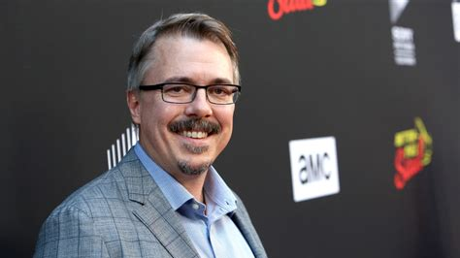

Slide 42
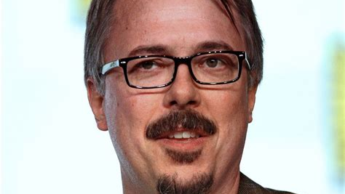

Slide 43
What this man tells in the series?

Slide 44
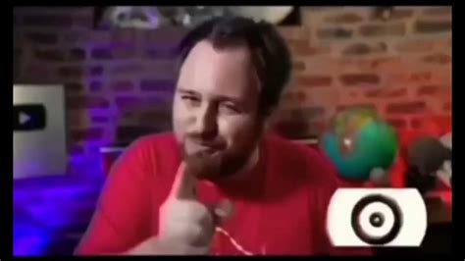

Slide 45
If you didnt watched yet i highly reccomend it

Slide 46
Any questions?

Slide 47
PERFECT

Slide 48

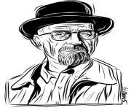

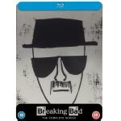



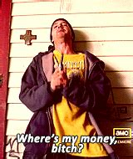

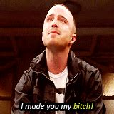

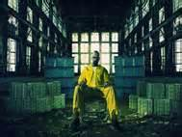



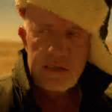
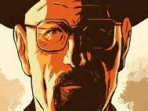
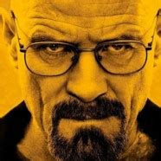
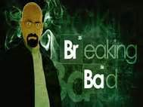
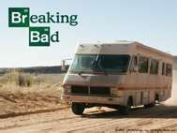

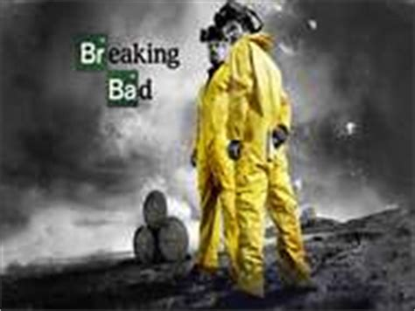
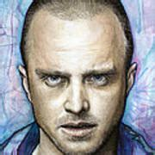

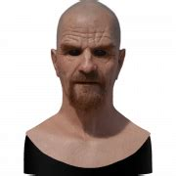

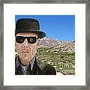
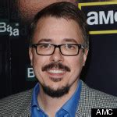
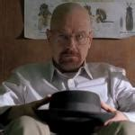


Thanks for listening

